Slide 1

Healthcare Analysis for Doctor Visits_TIRTC
Sofia TM

Slide 2

PROBLEM STATEMENT
Analyze patient visit data to identify which groups visit doctors more
frequently.
Explore how illness, health status, and chronic conditions relate to
visit patterns.
Provide data-driven insights to help hospital management improve
healthcare services.

Slide 3
Project Description
  This project leverages Python, Pandas, and data visualization to analyze patterns in doctor visit frequency. It examines how factors such as illness type, overall health status, age group, and chronic conditions influence healthcare utilization. The resulting insights equip hospital management with a data-driven understanding of patient needs, enabling them to identify opportunities for improving service delivery and resource allocation.

Slide 4

WHO ARE THE END USERS?
Hospital management and administrators.
Doctors and healthcare professionals.
Healthcare planners and data analysts.
Public health organizations.

Slide 5

Technology Used
  Python
  Pandas
  Numpy
  Matplotlib
  Seaborn
  GoogleCollab

Slide 6
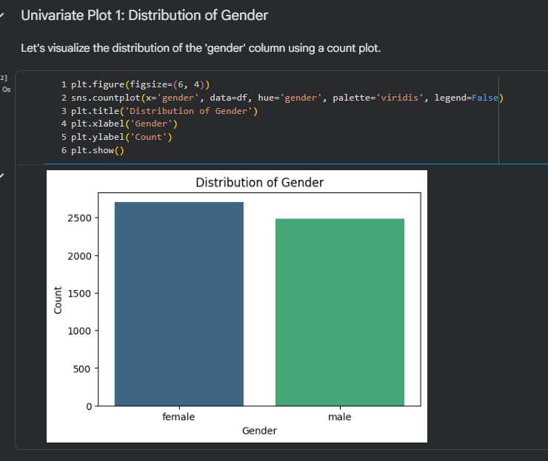
RESULTS
Demo Link

Slide 7
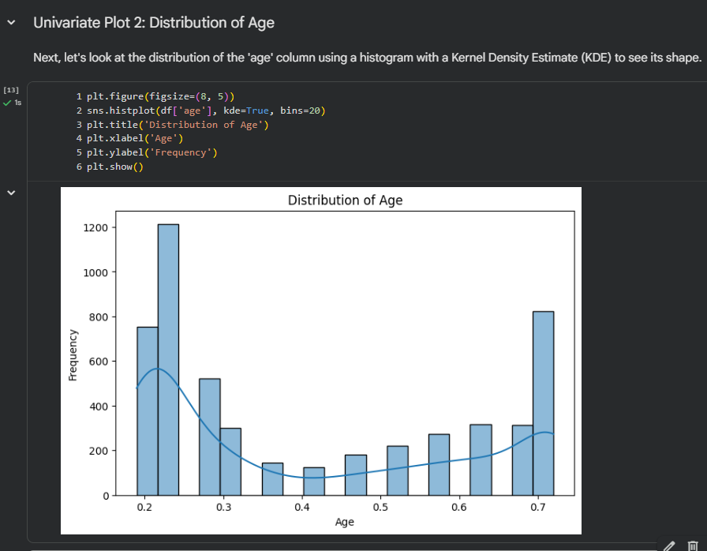
RESULTS
[Add screen shots of your code ]
Demo Link

Slide 8
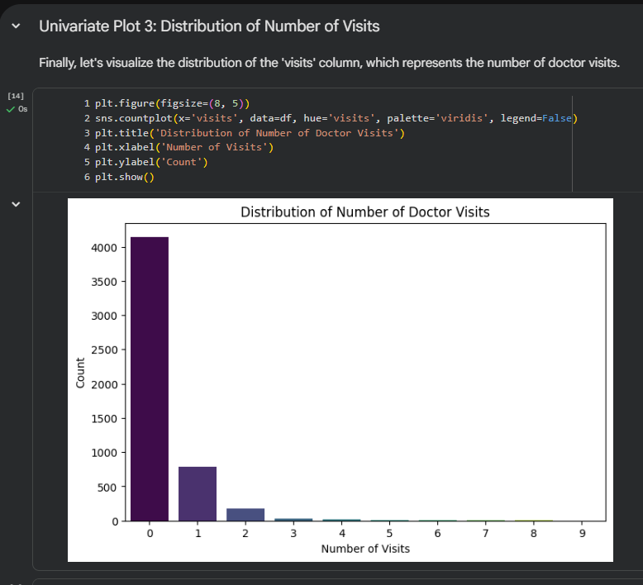
RESULTS
[Add screen shots of your code ]
Step | Description
Data Overview | Preview rows, check data types, and summary statistics
Missing Value Check | isnull().sum() to confirm data completeness
Univariate: Gender | Count plot of gender distribution
Univariate: Age | Histogram + KDE of age distribution
Univariate: Visits | Count plot of number-of-visits distribution
Bivariate: Visits by Gender | Grouped aggregation (count, mean, median) and bar plot of average visits per gender
Demo Link

Slide 9
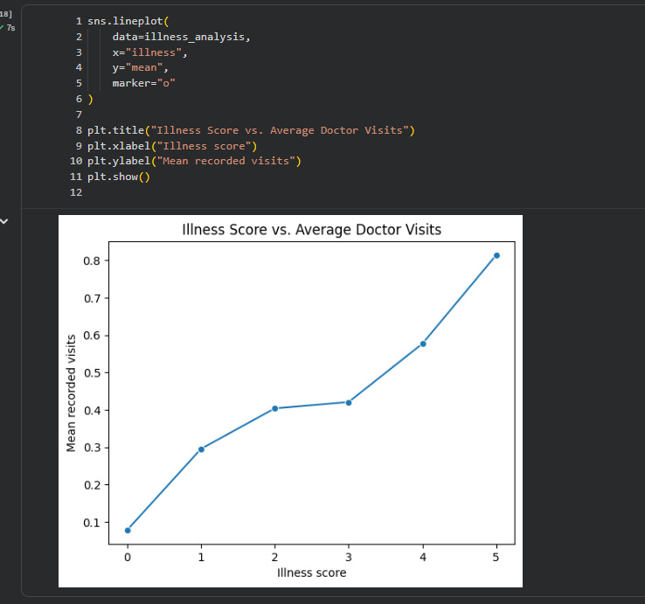
RESULTS
[Add screen shots of your code ]
Demo Link

Slide 10
RESULTS
github link: https://github.com/Sofia6002/Healthcare_Analysis_for_Doctor_Visits_TIRTC
Demo Link

Slide 11
Thank you
.
.

